Slide 1

Unravelling ChatGPT: Training & Architecture Assignment 7: A Deep Dive into architecture and training of ChatGPT
Devesh Surve
20th March 2024
ID: 002766974

Slide 2
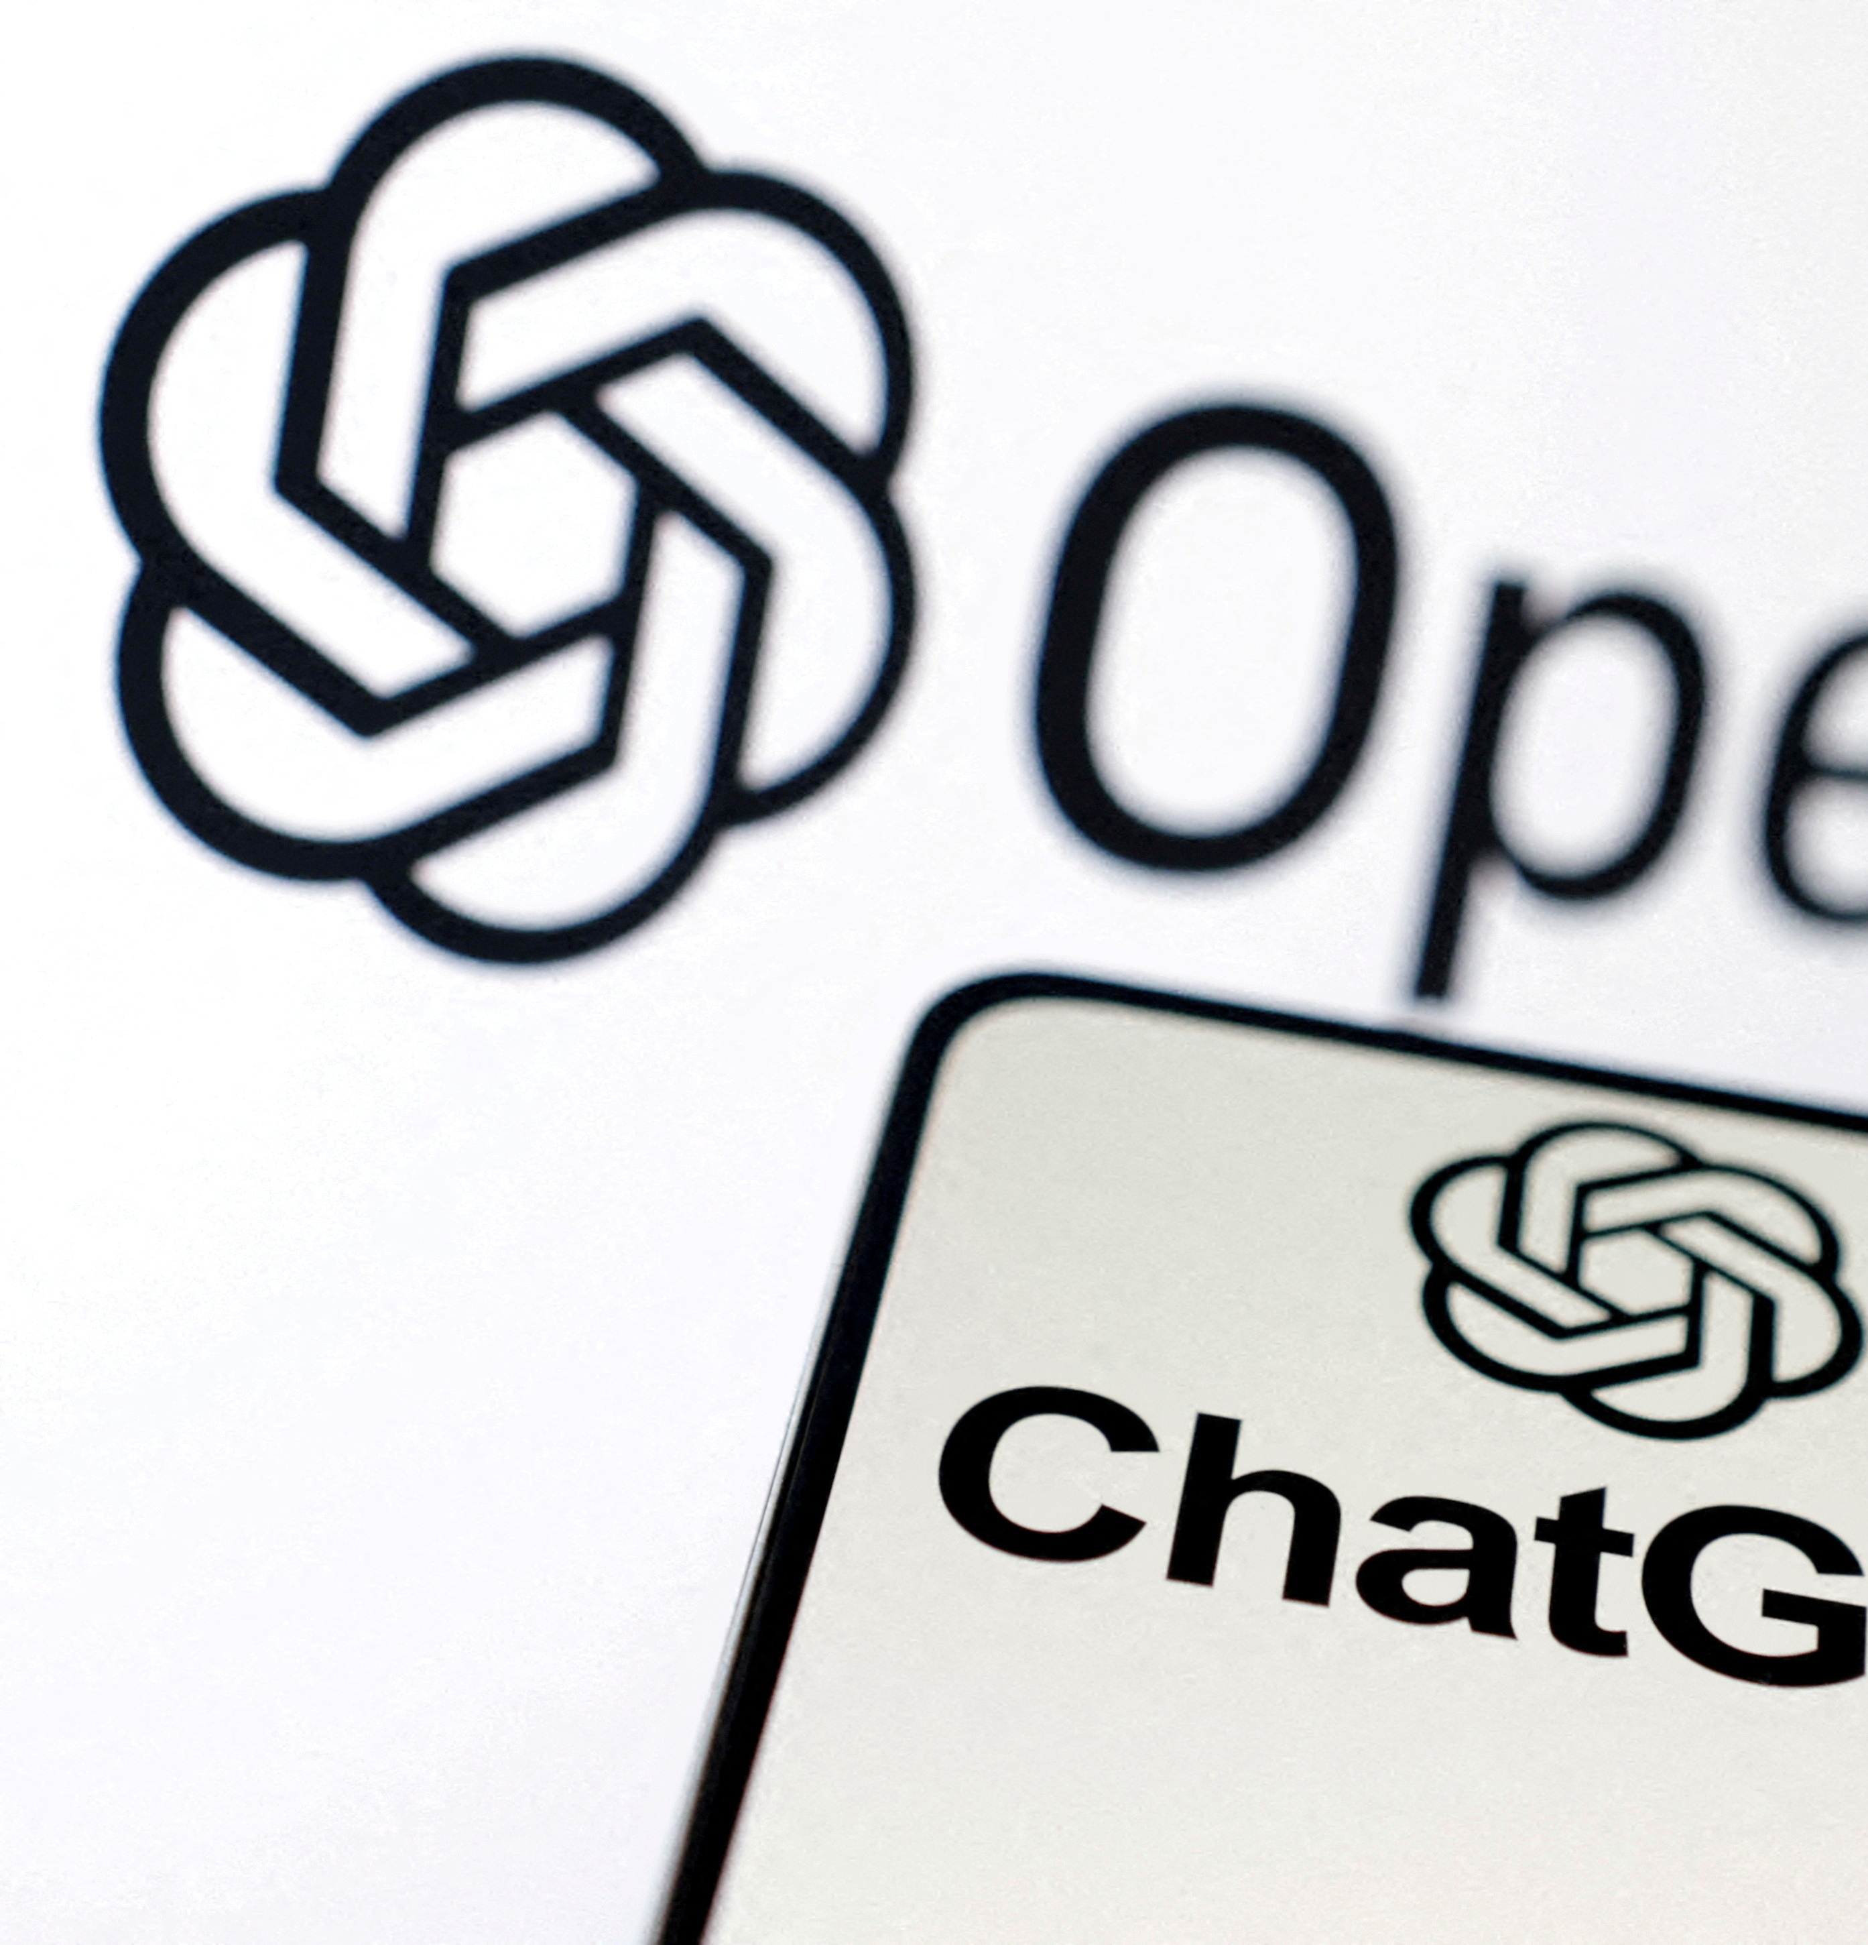
Why understand ChatGPT ?
What is ChatGPT?
A state-of-the-art language generation model developed by OpenAI.
Utilizes deep learning to produce text that resembles human writing.
Core Features
Human-like Text Generation: Capable of writing essays, poems, code, and more.
Conversational Abilities: Engages in dialogue, answers questions, and performs specific tasks.
Learning from Feedback: Improves over time through training and user interactions.
Why ChatGPT?
Innovation in AI: Pushes the boundaries of what artificial intelligence can achieve in understanding and generating human language.
Versatility: Finds applications in various fields such as customer service, education, content creation, and more.
Enhancing Human-AI Interaction: Makes interactions with AI more natural and intuitive.
The Impact
ChatGPT represents a leap forward in making AI accessible and useful for everyday tasks and complex problem-solving.
Sparks discussions on the ethical use, implications, and future of AI in society.

Slide 3
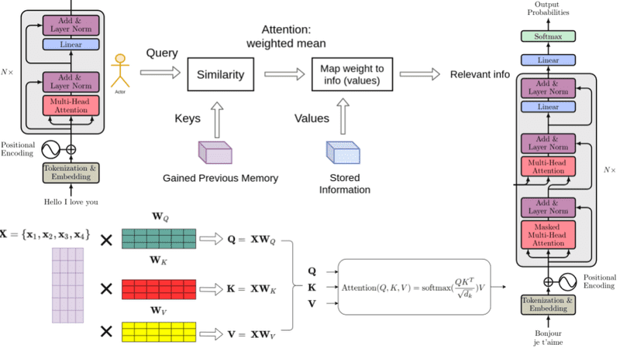
The Architecture of ChatGPT
The Shift in Transformer Architecture
Traditional Approach: Standard transformers utilize encoder and decoder components to handle tasks like translation and summarization.
GPT’s Innovation: Adopts a decoder-only framework, streamlining the process by eliminating the encoder stage, enhancing efficiency and directness in language processing.
Fundamentals of the Decoder-Only Model
Masked Self-Attention: Employs a variant of self-attention where the model can only focus on preceding words, not future ones, essential for predictive language modeling.
Direct Input Processing: Without an encoder, input data is fed directly into the decoder, maintaining richness in textual context without prior abstraction.
Why Opt for Decoder-Only?
Simplification and Speed: Reduces model complexity, resulting in faster processing and output generation, crucial for real-time applications.
Unsupervised Learning Power: Thrives on vast amounts of unlabeled data, making it ideal for language modeling where labeled datasets are scarce.
Performing Encoder-Decoder Tasks
Versatility of the Decoder: Despite lacking an encoder, GPT's advanced decoder is adept at understanding context and generating coherent outputs for various NLP tasks.
Training Approach: Utilizes unsupervised learning, predicting subsequent words based on prior context, which inadvertently teaches the model about language structure and semantics.

Slide 4
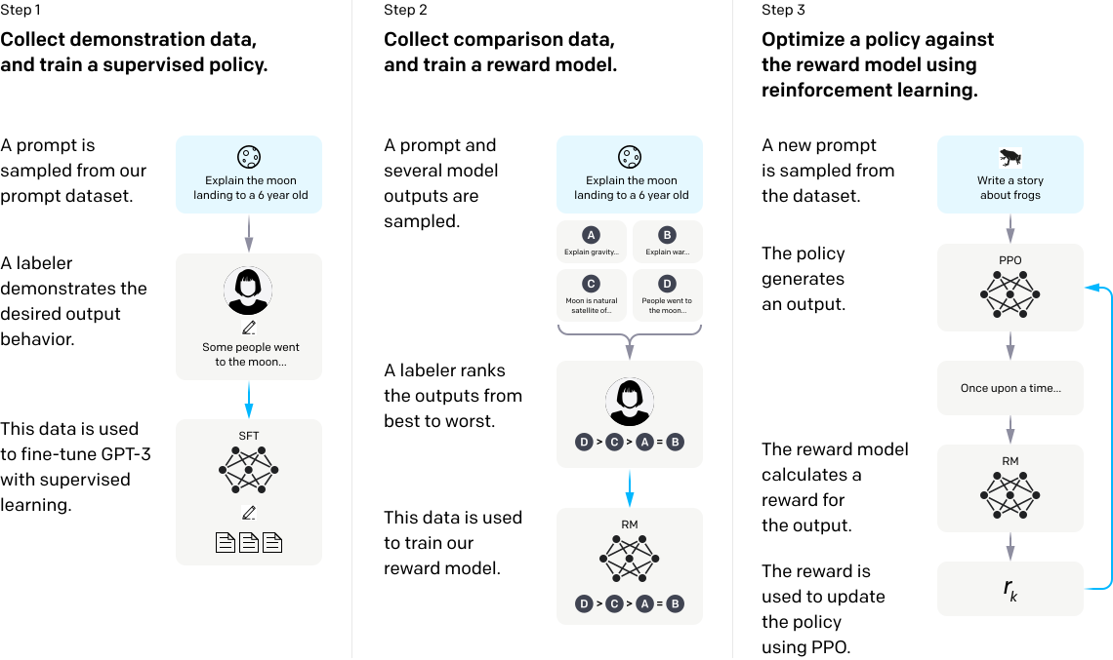
The Three-Step Training Process of ChatGPT
1. Supervised Fine-Tuning
What It Is: Training the model using a dataset of human-written conversations.
Purpose: To teach the model the basics of human conversation
Process: Labellers provide responses to prompts, which are used to adjust
2. Reward Modelling
What It Is: Method to evaluate the quality of model-generated texts
Purpose: what makes a response more human-like, informative, and engaging.
Process: Labellers rank multiple outputs from best to worst, creating the reward model
3. Reinforcement Learning from Human Feedback (RLHF)
What It Is: Fine-tuning based on the reward model using RL
Purpose: Iteratively improve the model's response quality by rewarding
Process: The model generates responses to new prompts, receives feedback from the reward model, and updates its parameters with PPO

Slide 5
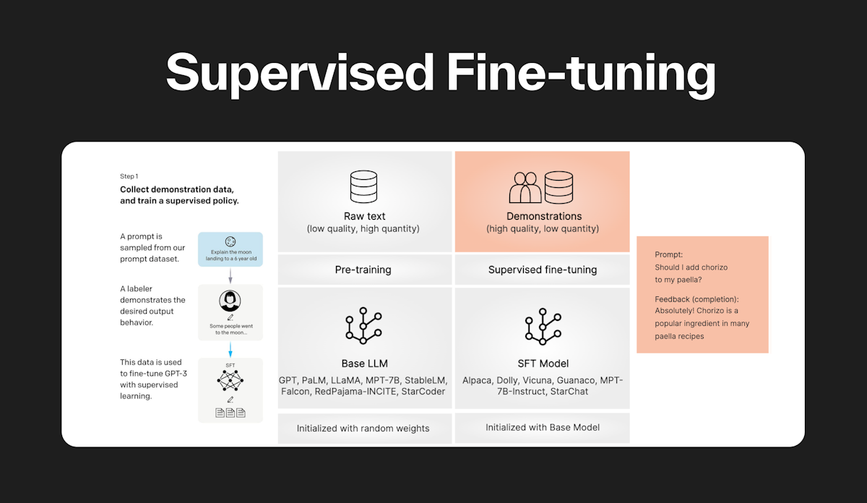
Step 1 - Supervised Fine-Tuning
The Goal of Supervised Fine-Tuning
To teach the model the foundational aspects of human conversation and text generation.
Ensure the model understands language syntax, semantics, and context.
How It Works
Training Data: The model is trained on a dataset consisting of conversation prompts and the corresponding human-generated responses.
Demonstration: A labeler (human annotator) provides examples of ideal responses to various prompts.
Learning: Model's weights are adjusted based on the gradients derived from the task-specific loss, which measures the difference between the LLM's predictions, and the ground truth labels
The Importance of Supervised Fine-Tuning
Baseline Performance: Establishes a strong starting point for the model's conversational abilities.
Guidance: Provides the model with a clear example of what good responses look like.
Efficiency: Helps to ensure that the model's initial outputs are already of high quality

Slide 6
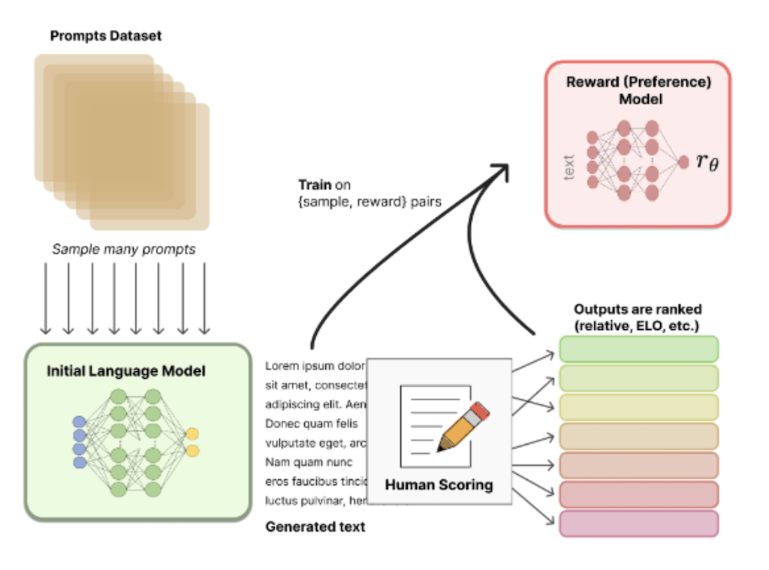
Step 2 – Reward Modelling
Understanding Reward Modeling
Purpose: To evaluate and rank the quality of model-generated responses, guiding the model towards better performance.
Process: Involves comparing several model outputs for a given prompt and ranking them based on their relevance, coherence, and human-likeness.
Key Components
Sampling Outputs: Generate multiple responses from the model for various prompts.
Human Evaluation: Labelers assess and rank these responses from best to worst.
Training the Reward Model: Use these rankings to teach a separate model (the reward model) what constitutes a good response.
The Impact of Reward Modeling
Quality and Relevance: Ensures the generated text is not just grammatically correct but also contextually relevant and engaging.
Ethical Considerations: Helps in minimizing biases and promoting fairness by emphasizing high-quality, balanced outputs.
Example: Practica Application
Comparative Ranking: Demonstrated through selecting the best explanations, stories, or answers, illustrating how diverse and nuanced responses can be effectively evaluated.

Slide 7
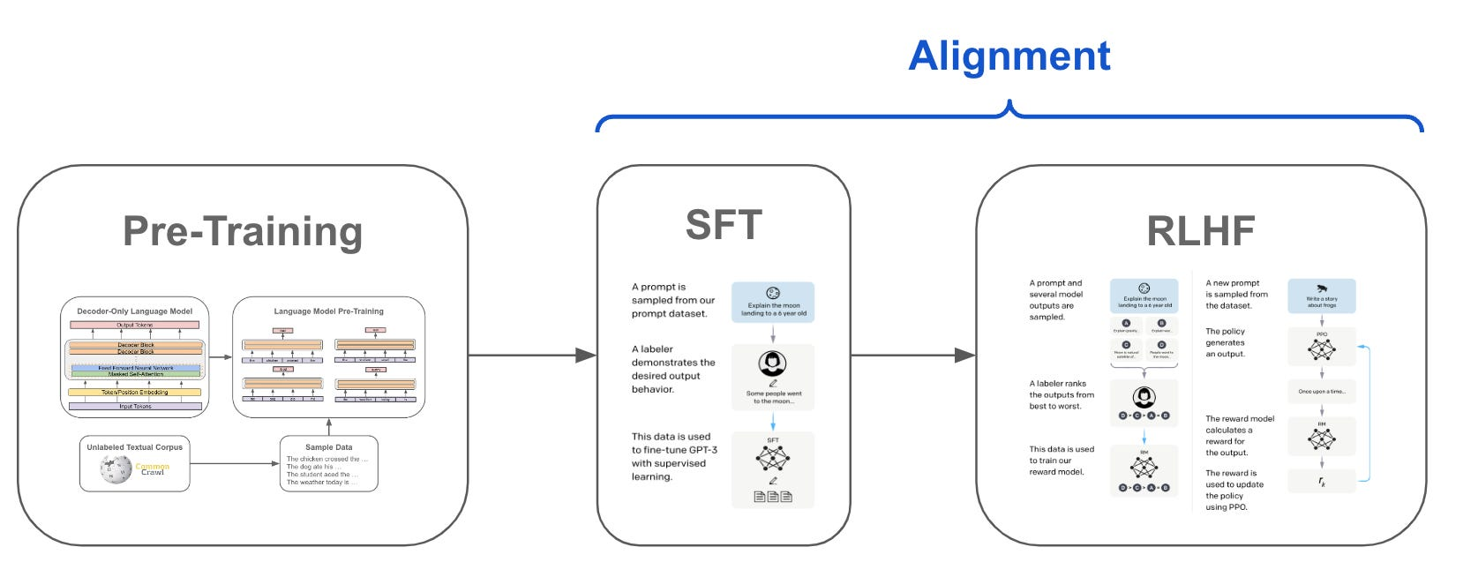
Step 3 - Reinforcement Learning from Human Feedback (RLHF)
What is RLHF?
Purpose: Fine-tune the model's outputs based on human feedback
Mechanism: Uses techniques from reinforcement learning, particularly Proximal Policy Optimization (PPO), to update the model parameters according to the reward signals received from human evaluations.
How RLHF Works
Integration of Human Feedback: The model is presented with text generations and corresponding feedback from the reward model.
Policy Update: Adjust the model (policy) to increase the likelihood of responses that received positive feedback.
Continuous Improvement: Iteratively refine the model using batches of human feedback to steadily improve response quality and relevance.
Importance of RLHF
Dynamic Learning: Allows the model to adapt to new information and user preferences over time.
Quality Control: Ensures the generation of responses that meet high standards of coherence, contextuality, and ethical guidelines.
User Alignment: Helps align the model's outputs with human values and expectations.

Slide 8
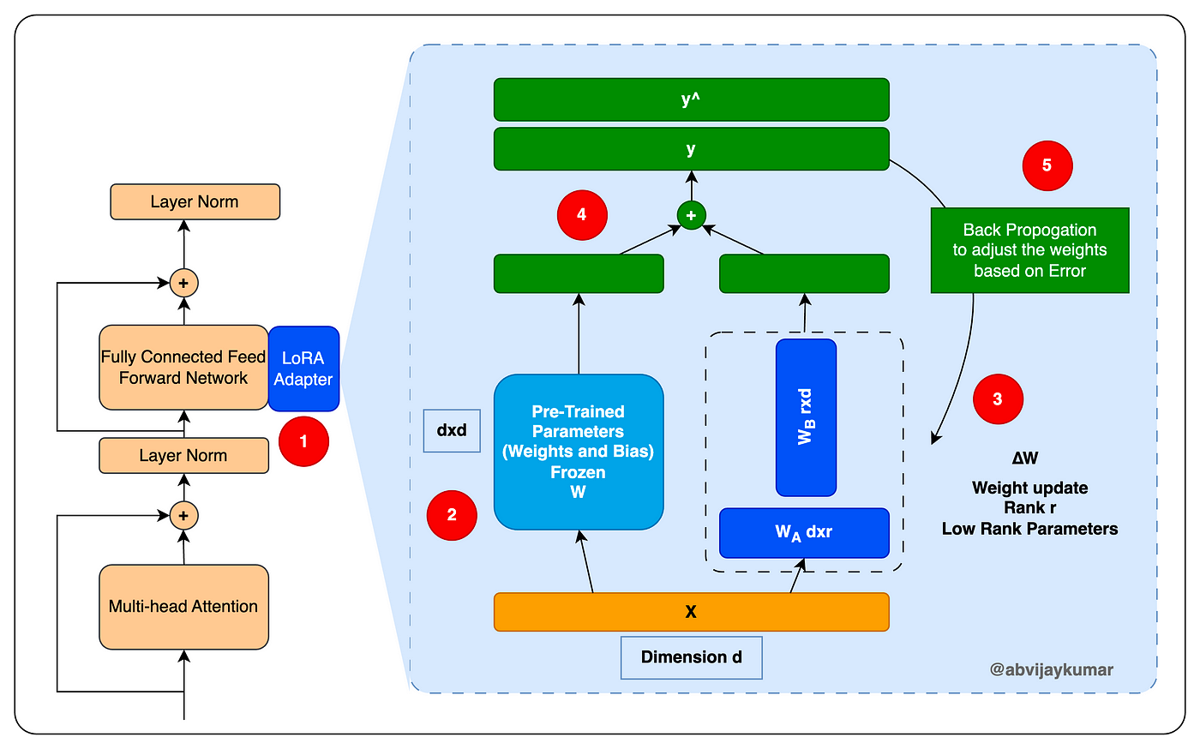
Technical Enhancements in User-Data Fine-Tuning for ChatGPT
Incorporating Advanced Fine-Tuning Techniques
Techniques Overview: Utilize Parameter-Efficient Fine-Tuning (PEFT) methods like Low-Rank Adaptation (LoRA) to update ChatGPT based on user feedback while maintaining computational efficiency.
Focus: Adapt the model to user preferences and feedback while avoiding extensive retraining.
Integrating User Feedback
Process: Collect and preprocess user feedback. Apply PEFT techniques to make targeted updates to the model's parameters, improving relevance and personalization.
Example: Implementing LoRA to adjust specific parts of the model influenced by user interactions.
Addressing Technical Challenges
Key Challenges: Scalability of updates, bias mitigation, and ensuring parameter updates don't compromise general performance.
Solutions: Advanced analytics for bias detection, differential privacy for data protection, and focused parameter updates to maintain model integrity.

Slide 9

Conclusion
References :
https://openai.com/research/instruction-following
https://subedi.medium.com/chatgpt-101-pre-training-56a98f04389
https://www.analyticsvidhya.com/blog/2023/05/how-does-chatgpt-work-from-pretraining-to-rlhf/
https://s3-us-west-2.amazonaws.com/openai-assets/research-covers/language-unsupervised/language_understanding_paper.pdf

